Slide 1
Week 1: Chapters 1 & 2
Conflict Management (BUS-8419)

Slide 2


Chapter 1: What’s wrong with contemporary conflict management and what organizations do about it?
In this Discussion:
Putting conflict into context
What is conflict?
Two types of conflict

Slide 3

Chapter 1: What’s wrong with contemporary conflict management and what organizations do about it?
Course Requirements, Expectations
What are your course expectations?
About the Instructor
About the Course: The Syllabus, Textbook, Other Learning Materials, Grading, Course Requirements, Others

Slide 4


Chapter 1: What’s wrong with contemporary conflict management and what organizations do about it?
Reflection Questions
Have you taken conflict management, negotiation or conflict resolution courses before?
What is your experience with conflict management?

Slide 5

Chapter 1: What’s wrong with contemporary conflict management and what organizations do about it?
Why do you think Adler and Fisher say this? Explain.
“By necessity, leaders must be many things: strategists, warriors, moralists, peacemakers, artisans, technicians, managers, and more.”
– Adler and Fisher (2007)

Slide 6
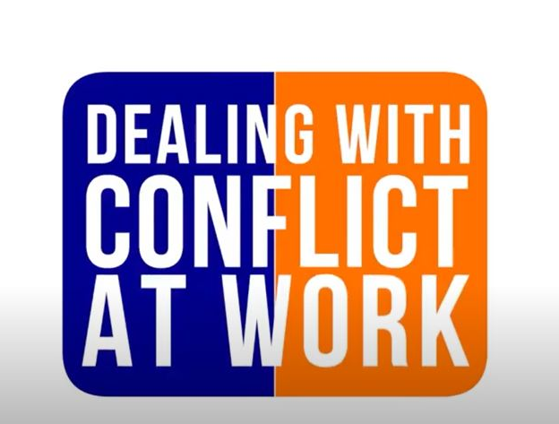
Chapter 1: What’s wrong with contemporary conflict management and what organizations do about it?
Featured Video:
What are Conflict and Conflict Management?
https://www.youtube.com/watch?v=qZhheu2h5uI

Slide 7
Chapter 1: What’s wrong with contemporary conflict management and what organizations do about it?
Let’s Talk about the Video
What are the essential ideas being promoted in the video?
Why do conflict and conflict management remain to be the major discussion points in the workplace?
How can this video help you as a professional?
https://www.youtube.com/watch?v=qZhheu2h5uI

Slide 8

Conflict as a Concept
Conflict occurs when one person (or a group) perceives that another person (or a group) is preventing him or her achieving his or her needs or is blocking him or her from expressing his or her values and beliefs in a way that he or she thinks is reasonable.

Slide 9

Conflict as a Concept
An expressed struggle between at least two interdependent parties, who perceive that incompatible goals, scarce resources, or interference from others are preventing them from achieving their goals.

Slide 10
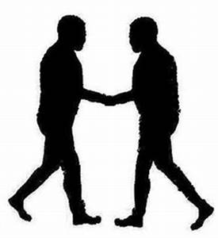
Why is Conflict still Happening?
Conflict is a complex subject.
The best response is to promote dialogue between the disputing parties.
Many organizations still turn to formal processes for managing conflict in the belief that these will spit out two happy people and a lasting resolution.

Slide 11
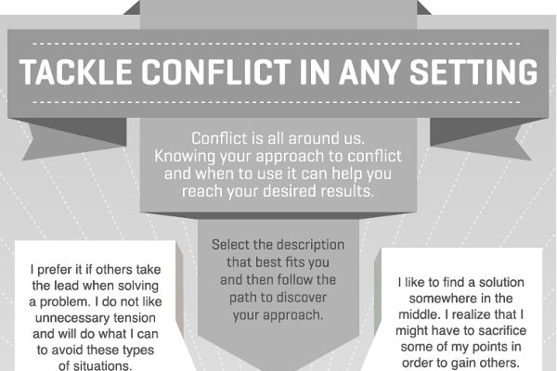

Slide 12

Discussion of Selected Reading 1
Critically discuss the salient features of the reading. How does it contribute to your day to day interaction at work?
Critique the journal article. What are its limitations?

Slide 13
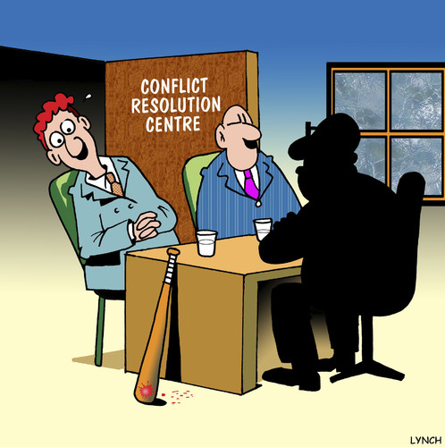
On Conflict Management
Conflict management is about helping people to modify or ‘reframe’ their perceptions of themselves and of the other person. For example:
They did it on purpose’ becomes ‘It’s impacted negatively on me, but I don’t really know what their intentions were.’
They are wrong’ becomes ‘Neither of us is entirely wrong nor entirely right.’
They are a bully’ becomes ‘They have hurt me, and I need them to stop.’

Slide 14
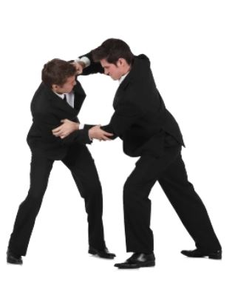
Kinds of Conflict
Internal: Conflict with one’s self
External: Conflict with others

Slide 15
The Outward symptoms of a
Difficult Internal Conflict
Not sleeping properly (insomnia)
Inability to ‘switch off’ or relax.
Feeling tired all of the time (often because of the lack of sleep and inability to relax).
Struggling to concentrate on tasks and during conversations.

Slide 16

The Outward symptoms of a
Difficult Internal Conflict
Irritability or mood swings.
Physiological symptoms may include irritable bowel syndrome (IBS), eczema, weight gain/loss, increased propensity to pick up cold and flu bugs, feeling run down, backache and painful shoulders or necks, etc.

Slide 17
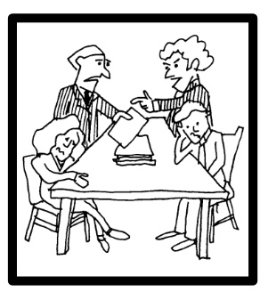
On External Conflict
Differences with a colleague, a co-worker, a boss or a customer.
Occurs when an individual (or a group of individuals), believe that another individual (or a group of individuals) is preventing him or her from achieving his or her needs or goals

Slide 18
On External Conflict
Preventing access to the resources he or she requires to achieve his or her needs or goals
Preventing him or her from expressing his or her values or beliefs in a way which he or she considers to be reasonable.

Slide 19

Resolution Reflection Questions
Reflect on an internal conflict that you have experienced:
What impact did it have on you?
How did you resolve it?
What did you learn from it?

Slide 20

Understanding Conflict
It is part of everyday phenomenon in each organization.
It is impossible to avoid, but it is possible to manage them in a way that we recognize the conflict symptoms in time.
It is necessary to continuously track the organizational signals, which point to their existence.
Problems mostly occur in those organizations where the business results directly depend on collaboration, teamwork and creativity, among others.

Slide 21

Understanding Conflict
Disagreement occurs when goals, interests or values of various individuals or groups are incompatible
Demotivation, reduction of work performance efficiency, reduced communication among employees
Conflict itself does not have to be negative; the majority of conflicts can in fact be an excellent ground for accomplishment of better business results

Slide 22

Understanding Conflict
Adequate conflict management can lead to series of positive effects like stimulation of creativity and innovation within the company
Enables us constant new learning, new knowledge and a potential growth and development of organization

Slide 23
Scenario: Putting Conflict into Context
Sarah and Mike were in a long running dispute following a comment that Mike overheard Sarah making one day on the phone. She accepted that she described him as ‘disorganized and unprofessional’ but she maintains that it was said as a joke. Mike didn’t see the funny side and refused to speak to Sarah for six months. One Tuesday, Mike got cross with Sarah about a relatively minor issue. He allegedly shouted at her and was verbally abusive. Sarah put in a grievance against Mike. The issue was investigated over a period of six weeks and a panel was convened to reach a determination. The outcome was that there was no case to answer. Sarah felt that no one believed her and that she wasn’t trusted – she left the business shortly after. Mike felt let down by the whole process and he became reclusive and quiet. He didn’t bother applying for a promotion, believing that this was a stain against his name.
Identify the nature of conflict. What can be done?

Slide 24

Two Types of Conflict
Functional Conflict: Key component of high-functioning and high-performing teams
Dysfunctional Conflict: It is harmful, stressful and costly

Slide 25
Two Types of Conflict
Functional Conflict: Constructive Conflict
Also called healthy disagreement, creative conflict, cooperative conflict or cognitive conflict.
The parties are engaged in dialogue and they are focused on achieving an outcome that is mutually acceptable.
The parties seek win/win outcomes and neither party wishes to cause harm to the other.
It exists where the parties are willing to engage with one another to generate enhanced levels of insight, understanding and learning.
Requires open and honest dialogue, empathy, self-awareness and a willingness to change.

Slide 26
Two Types of Conflict
Dysfunctional Conflict: Destructive Conflict
Dysfunctional conflict may also be called affective conflict, bullying, mobbing, intimidation, harassment, oppression, discrimination, violence or confrontation.
Generates little, if any, benefit for the parties, their colleagues or the organization as a whole.
This kind of conflict rarely ends well.
If left unresolved, dysfunctional conflicts will have a significant impact on the psychological, emotional and physiological wellbeing of employees and managers.

Slide 27

Chapter 1 Key Learning Points
Workplace conflict is a taboo subject and it is widely misunderstood.
Conflict is inevitable and unavoidable.
There are broadly two types of conflict: dysfunctional (unhealthy and destructive) and functional (healthy and constructive).

Slide 28
Chapter 1 Key Learning Points
Resulting from organizations’ focus on managing the risks and fallout from dysfunctional conflict, the potential to transform conflict into functional, healthy and constructive dialogue is often missed.
Workplace conflict is a taboo subject and it is widely misunderstood.
Conflict is inevitable and unavoidable.

Slide 29
Chapter 1 Key Learning Points
There are broadly two types of conflict: dysfunctional (unhealthy and destructive) and functional (healthy and constructive).
Resulting from organizations’ focus on managing the risks and fallout from dysfunctional conflict, the potential to transform conflict into functional, healthy and constructive dialogue is often missed.

Slide 30
Chapter 1 Key Learning Points
Rights-based, adversarial, divisive and confrontational policy frameworks such as the traditional grievance procedure and bullying policies are ineffective at managing workplace conflict.
Over the past 10 years, there has been a lack of coherent guidance from policy makers for organizations that wish to adopt innovative systems for managing conflict such as resolution triage assessments, early resolution, facilitated roundtable conversations or mediation.

Slide 31

Conclusion
Dysfunctional conflict is bad for business, it is bad for anyone who is required to manage it and it is most certainly bad for the disputing parties.
The traditional systems for managing conflict are proving, time and time again, to be ineffective.
There seems to be a reluctance by organizations to fully embrace new approaches for managing conflict such as early resolution, resolution triage assessment, facilitated roundtable conversations and mediation.
These approaches, are, as this book will demonstrate, proven remedies to conflict.

Slide 32
References
CIPD (2015) Conflict Management: A shift in direction? CIPD, London, p 12
CIPD (2015) Getting Under the Skin of Workplace Conflict: Tracing the experiences of employees, CIPD, London, p 13
Gibbons, M (2007) Better Dispute Resolution: A review of employment dispute resolution in Great Britain, DTI, London
Jung, C G (1970) Structure and Dynamics of the Psyche: Vol 8, Collected Works of Jung, eds G Adler, M Fordham and H Read, Princeton University Press, Princeton, NJ
Kilmann, R and Thomas, K W (1977) Developing a forced-choice measure of conflict-handling behavior: The ‘mode’ instrument, Educational and Psychological Measurement, 37, p 309
Lederach, J L (2003) Little Book of Conflict Transformation, Good Books, Skyhorse Publishing, New York
Saundry, R et al (2016) Managing Individual Conflict in the Contemporary British Workplace, ACAS, London

Slide 33
Chapter 2: The lifecycle of a conflict: How and why conflicts escalate?
In this Discussion:
Causes of conflict
Stages of conflict
Types of team conflict
Signs of conflict
Effects of conflict
Tips for managing conflict

Slide 34
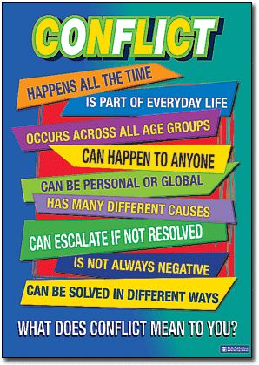
From the Expert
You are not stuck in traffic – you are the traffic.
(TomTom satnav advert)

Slide 35
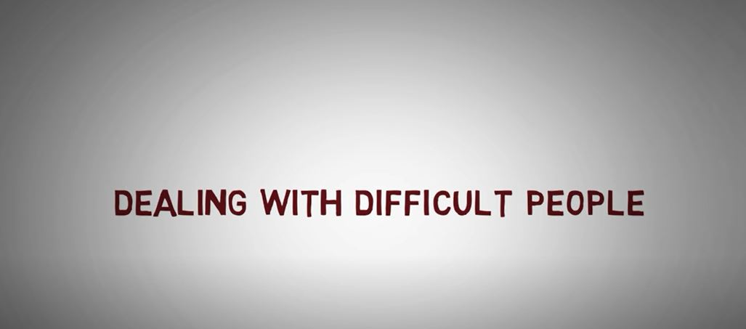
Chapter 1: What’s wrong with contemporary conflict management and what organizations do about it?
Let’s Talk about the Video
Why is it important to understand the nature of difficult people?
Discuss the take-away concepts/ interesting part of the video and how it can help you in your current job.
https://www.youtube.com/watch?v=pmVF23QXY10

Slide 36
Chapter 1: What’s wrong with contemporary conflict management and what organizations do about it?
Featured Video:
Dealing With Difficult & Annoying People
https://www.youtube.com/watch?v=pmVF23QXY10

Slide 37
Scenario: Reflection Questions
Consider a conflict that you have been involved in in the office with a colleague. This may be a workplace conflict (a conflict with a co-worker at the same department with same level of position and tenure as yours, or a conflict with your immediate head) that bothers you a lot.
What were the causes of the conflict?
Were there any observable stages at which the conflict escalated?
How and when was the conflict resolved?

Slide 38
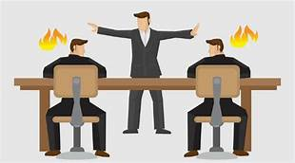
Causes of Conflict
Scarcity of resources (finance, equipment, facilities, etc.)
Different attitudes, values or perceptions
Disagreements about needs, goals, priorities and interests
Poor communication
Poor or inadequate organizational structure
Lack of teamwork
Lack of clarity in roles and responsibilities
Others

Slide 39
The Lifecycle of a Conflict
Every conflict, has a definite lifecycle and most track the same course.
Each stage of the conflict presents an opportunity for resolution but also a risk of escalation if it is not dealt with appropriately.
At the later stages, the parties are often exhausted and many of the routes to resolution have been exhausted also.
As the parties stare into what I call ‘the precipice of doom’, they realize that resolving it now is better than falling over the edge into the unknown.
Nothing focuses a mind better than a precipice. In these cases, the parties may have to walk backwards in order to walk forwards – but at least they are moving.

Slide 40

Discussion of Selected Reading 2
How does this reading contribute to your line of work?
How can such reading be beneficial to a graduate student like you?

Slide 41
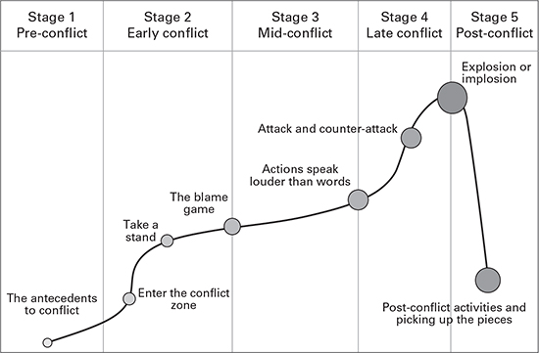
The Five Stages of Conflict

Slide 42
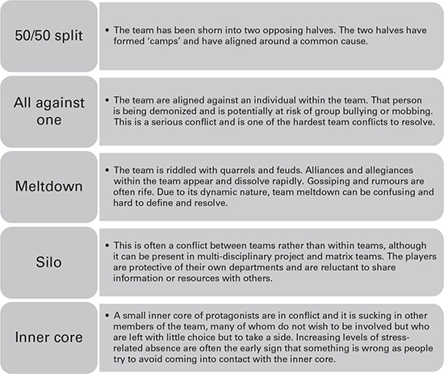
Types of Team Conflict

Slide 43

Signs of Conflict
Colleagues not speaking to each other or ignoring each other
Deliberately undermining or not co-operating with each other, to the downfall of the team
Others

Slide 44

Effects of Conflict
Stress
Absenteeism
Staff turnover
Demotivation
Non-productivity
Improves decision quality
Stimulates creativity
Encourages interest
Destructive Effect
Constructive Effect

Slide 45

Top tips for managing conflict
at the post-conflict stage
Are there any burning issues that still require a resolution?
What have you learnt from the conflict?
What are our shared goals and objectives for the future – our common cause?
How do we want to behave towards each other in the future?
What does a good day look like for our team?

Slide 46
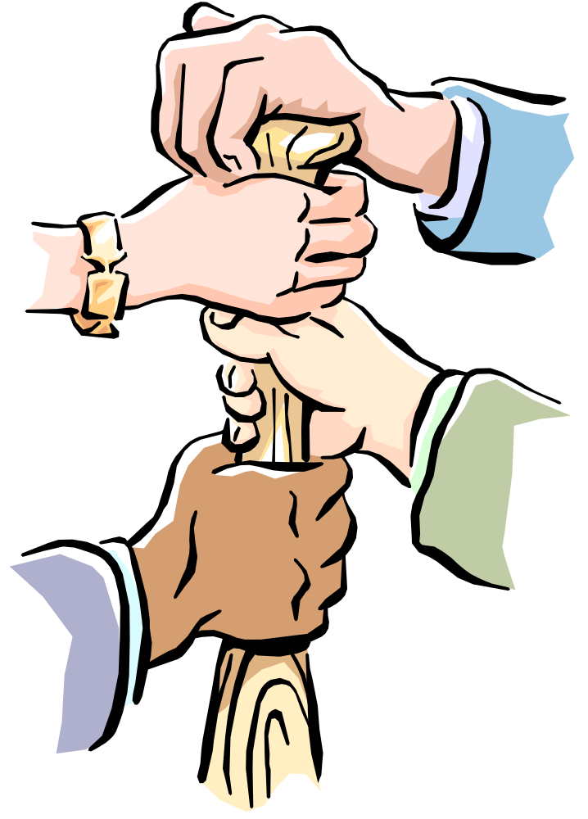
Top tips for managing conflict
at the post-conflict stage
What collective and individual actions will we take to prevent a similar situation occurring again?
What support do we need now to achieve our actions as well as our shared goals and objectives?
What early warning systems do we need to tell us if we are going off track?
What do we need our leaders to do to helps us achieve our goals and objectives?
Are we all ready to move forward – together?

Slide 47

Unresolved Conflicts in Teams
Forming
Storming
Norming
Performing

Slide 48
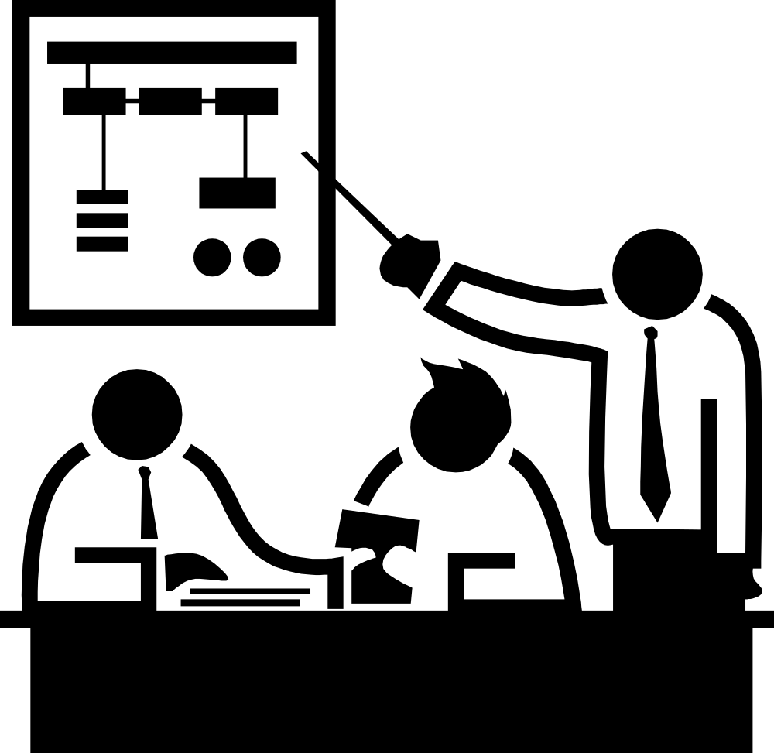
Unresolved Conflicts in Teams
Forming: There is a high risk of dysfunctional conflict due to the relatively high levels of confusion and a lack of clear direction and the unclear nature of leadership.
Storming: The team’s purpose and aims are being developed. The potential for dysfunctional conflict is very high.

Slide 49
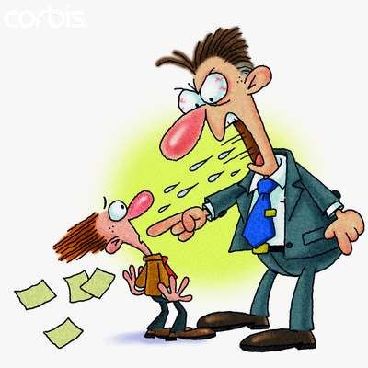
Unresolved Conflicts in Teams
Norming: There is a greater chance for functional conflict to occur if leaders are equipped to handle conflict effectively.
Performing: At this stage, leaders may stimulate some conflict to drive innovation.
In these cases, leaders need to be aware of the process of preventing dysfunctional conflict and promoting functional conflict.

Slide 50

Conclusion
Conflict within teams can have a significant impact and it can undermine the efforts of all team members at each stage of the team development.
Not all team conflicts are the same.
The leader may perceive such dissent as a challenge to his or her role and an attack on his or her status and position within the team.

Slide 51
Chapter 2 Key Learning Points
Conflict has a distinct lifecycle that is broadly predictable; it comprises five stages: pre-conflict, early conflict, mid-conflict, late conflict and post-conflict.
There are a variety of conflict management interventions that can be used at each stage of the conflict lifecycle.

Slide 52
Chapter 2 Key Learning Points
Conflict avoidance is not a good management strategy – it generally leads to an escalation and simply puts off the inevitable.
There are several antecedents to a conflict at the pre-conflict stage. Planning conflict management into processes such as project teams and change programmes can be a useful way of preventing dysfunctional conflict from escalating.

Slide 53
Chapter 2 Key Learning Points
Conflict is nothing to be feared – when it is managed well, at any stage of the conflict lifecycle, it can be a positive and deeply affirming experience for the parties and for the person managing it.
Corporate conflict management strategies should take account of each stage of the conflict lifecycle and appropriate remedies and resources should be put in place to resolve conflict at each stage.

Slide 54
References
Tuckman, B W (1965) Developmental sequence in small groups, PsychologicalBulletin, 63 (6), pp 384–99.

Slide 55
Readings for Next Class
Causes and the source of dysfunctional conflict
Managing conflict as an entrepreneur
Selected Journal Readings

Slide 56
That’s it. Enjoy reading and participate more.
Thank you!

